Slide 1
Model Validation

Slide 2
Model Validation
Training Data vs. Test Data

Slide 3
Training Data vs. Test Data
TRAINING DATA
Data used to develop the Predictive Model
For this class, the predictive model will be
Linear Regression
Logistic Regression
Generalized Linear Model
Could also be any number of other modeling techniques such as: Decision Tree, Neural Network, Support Vector Machine, Etc.
Model Validation Using Training Data
Metric that rewards for accuracy and penalizes for complexity
Examples:
AIC, SBC, AICC, etc.

Slide 4
Training Data vs. Test Data
TEST DATA
Data that was NOT used to develop the Predictive Model.
Target value is known
Predictive Model “predicts” Target.
Predicted value compared to Actual value
For a good model, there should be small error in Predicted versus actual Target.
Metric usually rewards accuracy without regard to complexity

Slide 5
Model Validation
Error and Deviation

Slide 6
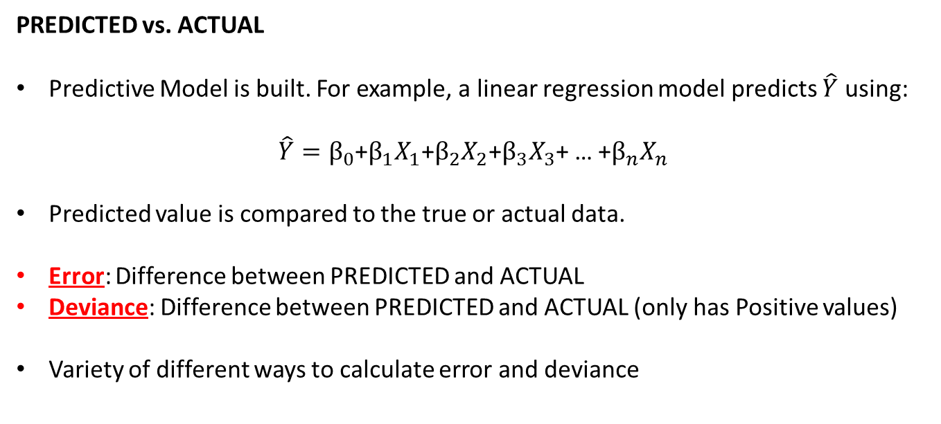
Error and Deviation
PREDICTED vs. ACTUAL
Predictive Model is built. For example, a linear regression model predicts $\hat{Y}$ using:
$\hat{Y}=β_{0}$+$β_{1}X_{1}\text{+}β_{2}X_{2}$+$β_{3}X_{3}$+ … +$β_{n}X_{n}$
Predicted value is compared to the true or actual data.
Error: Difference between PREDICTED and ACTUAL
Deviance: Difference between PREDICTED and ACTUAL (only has Positive values)
Variety of different ways to calculate error and deviance

Slide 7
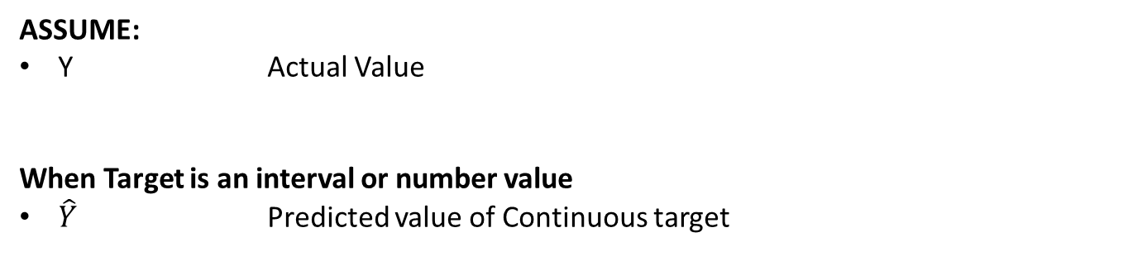
Error and Deviation
ASSUME:
Y Actual Value
When Target is an interval or number value
$\hat{Y}$ Predicted value of Continuous target

Slide 8
Model Validation
Error Calculations

Slide 9
Error Calculations
PROPERTIES OF ERRORS
Error = 0 implies perfect agreement between Actual and Predicted Value
Error can be Positive or Negative
The larger the magnitude of the error, the greater the disagreement between Predicted and Target.

Slide 10
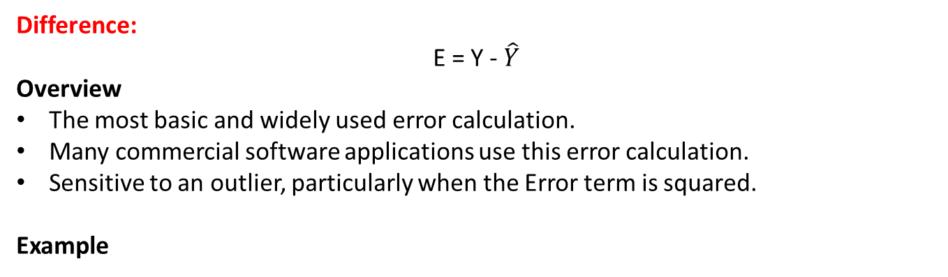
Error Calculations
Difference:
E = Y - $\hat{Y}$
Overview
The most basic and widely used error calculation.
Many commercial software applications use this error calculation.
Sensitive to an outlier, particularly when the Error term is squared.
Example
Y (Actual) | Y-Hat (Predicted) | Error
10 | 5 | 5
20 | 25 | -5
30 | 10 | 20
40 | 40 | 0
50 | 100 | -50

Slide 11
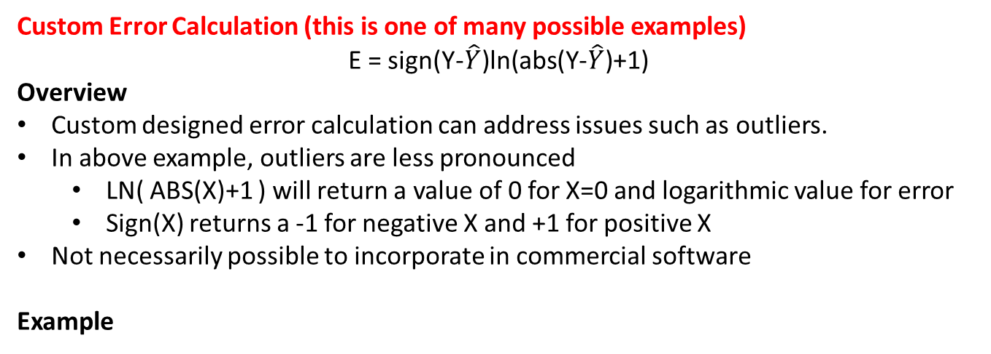
Error Calculations
Custom Error Calculation (this is one of many possible examples)
E = sign(Y-$\hat{Y}$)ln(abs(Y-$\hat{Y}$)+1)
Overview
Custom designed error calculation can address issues such as outliers.
In above example, outliers are less pronounced
LN( ABS(X)+1 ) will return a value of 0 for X=0 and logarithmic value for error
Sign(X) returns a -1 for negative X and +1 for positive X
Not necessarily possible to incorporate in commercial software
Example
Y (Actual) | Y-Hat (Predicted) | Error | Custom Error
10 | 5 | 5 | 1.61
20 | 25 | -5 | -1.61
30 | 10 | 20 | 2.99
40 | 40 | 0 | 0
50 | 100 | -50 | -3.91

Slide 12
Model Validation
Deviation Calculations

Slide 13
Deviation Calculations
PROPERTIES OF DEVIATION
Deviation = 0 implies perfect agreement between Actual and Predicted Value
Deviation can only be Positive
The larger the magnitude of the deviation, the greater the disagreement between Predicted and Target.

Slide 14
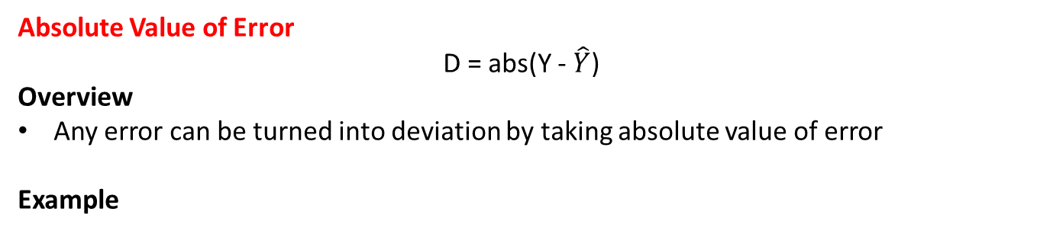
Deviation Calculations
Absolute Value of Error
D = abs(Y - $\hat{Y}$)
Overview
Any error can be turned into deviation by taking absolute value of error
Example
Y (Actual) | Y-Hat (Predicted) | Error | Deviation
10 | 5 | 5 | 5
20 | 25 | -5 | 5
30 | 10 | 20 | 20
40 | 40 | 0 | 0
50 | 100 | -50 | 50

Slide 15
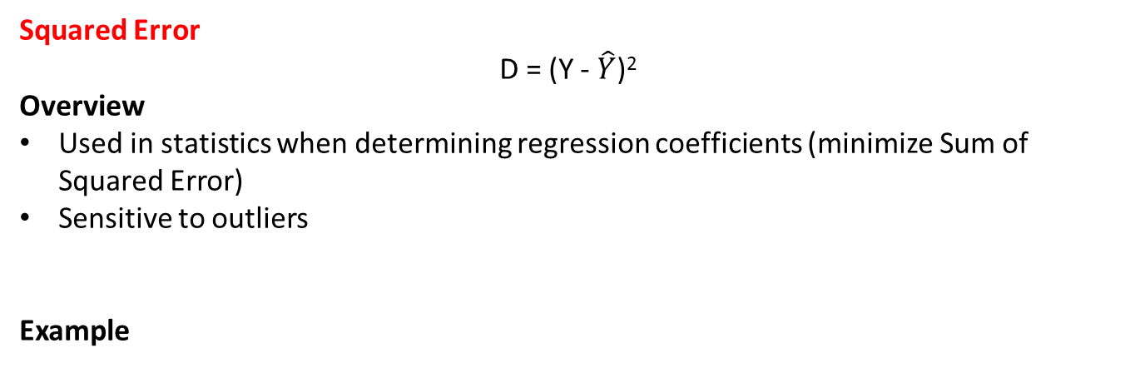
Deviation Calculations
Squared Error
D = (Y - $\hat{Y}$)²
Overview
Used in statistics when determining regression coefficients (minimize Sum of Squared Error)
Sensitive to outliers
Example
Y (Actual) | Y-Hat (Predicted) | Error | Error Squared
10 | 5 | 5 | 25
20 | 25 | -5 | 25
30 | 10 | 20 | 400
40 | 40 | 0 | 0
50 | 100 | -50 | 2500

Slide 16
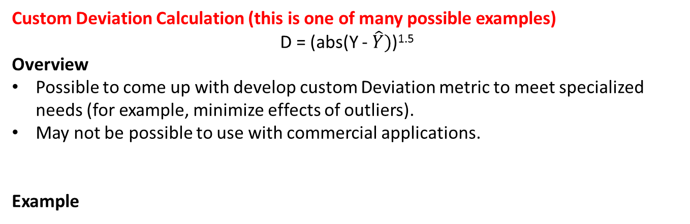
Deviation Calculations
Custom Deviation Calculation (this is one of many possible examples)
D = (abs(Y - $\hat{Y})$)^{1.5}
Overview
Possible to come up with develop custom Deviation metric to meet specialized needs (for example, minimize effects of outliers).
May not be possible to use with commercial applications.
Example
Y (Actual) | Y-Hat (Predicted) | Error | Error Squared
10 | 5 | 5 | 11.18
20 | 25 | -5 | 11.18
30 | 10 | 20 | 89.44
40 | 40 | 0 | 0
50 | 100 | -50 | 353.55

Slide 17
Model Validation
Metrics Using Training Data

Slide 18
Training Data Metrics
Using Training Data Performance To Test Models
Usually best to compare models based upon performance on TEST (“Holdout”) data
Not always possible because of small data set
Therefore, it is necessary to compare models on the TRAINING data
Cannot compare models based on lowest average Deviation
More complicated model tends to do better on TRAINING data
Metric is needed to reward accuracy but penalize complexity
Many metrics are used, most common metrics are:
AIC
SBC
AICC

Slide 19
Training Data Metrics
AIC, SBC, AICC
Commonly used metrics, available in most commercial software.
Allow comparing models with different numbers of parameters.
Algorithm:
Decide on a metric for Deviation (i.e. Sum of Square Error, Log Likelihood, etc.)
Make a prediction for each record using each competing model
Calculate each model’s Deviation for each of the records
Determine the average deviation
Calculate AIC, SBC, or AICC for all competing models
Model with smallest value is the preferred model
Over time, AIC, SBC, or AICC metrics have been adjusted by analysts for convenience.
It is possible (likely) to encounter different variations of these formulas.
Hand calculations of AIC, SBC, or AICC might differ from software output.
The differences are not important!
The importance is that the smallest value is the preferred model

Slide 20
Training Data Metrics
Instructor Opinion
Just because a model has a smaller AIC, SBC, or AICC value, does NOT mean it is the best model.
If another model has a value close to the most preferred model and it also has other desirable properties such as “easy to implement”, “will be more explainable to a regulator”, or “makes the boss happy” then the analyst should exercise their judgment and select the model with the less optimal score.
Never blindly follow a metric at the expense of common sense and experience !
“A tool in the hands of an idiot is a weapon”

Slide 21
Training Data Metrics
AIC (“Akaike Information Criterion”)
SBC (“Schwarz Bayesian Information Criterion”)
AICc (“Adjusted Akaike Information Criterion”)
DKWIC (“Donald K Wedding Information Criteria”) … You can make up your own
Variables:
N Number of data points in the data set
K Number of terms in the model
D Deviation
Means Square Error
Misclassification Rate
Total Log Likelihood

Slide 22
Training Data Metrics
AIC (“Akaike Information Criterion”)
AIC = 2K + N ln( D )
EXAMPLE: Calculate AIC for several different types of models
(not comparing them against each other, just calculating AIC)
Note: For LOGISTIC REGRESSION, the Total Deviation “D” is typically used for the “N ln(D)” term. Therefore, The Logistic AIC value will be: 2K + D
Model | Deviation Metric | Total D | N | D | K | AIC
Linear Regression | Sum of Square Error | 250 | 50 | 5 | 4 | 88.47
Classification Model | Misclassifications | 20 | 100 | 0.2 | 6 | -148.94
Logistic Regression | Maximum Likelihood | 80 | 40 | 80 | 5 | 90

Slide 23
Training Data Metrics
SBC (“Schwarz Bayesian Information Criterion”)
Greater penalty for complicated models
SBC = K ln(N) + N ln( D )
EXAMPLE: Calculate SBC for several different types of models
(not comparing them against each other, just calculating SBC)
Note: For LOGISTIC REGRESSION, the Total Deviation “D” is typically used for the “N ln(D)” term. Therefore, The Logistic SBC value will be: K ln(N) + D
Model | Deviation Metric | Total D | N | D | K | SBC
Linear Regression | Sum of Square Error | 250 | 50 | 5 | 4 | 96.12
Classification Model | Misclassifications | 20 | 100 | 0.2 | 6 | -133.31
Logistic Regression | Maximum Likelihood | 80 | 40 | 80 | 5 | 98.44

Slide 24
Training Data Metrics
AICc (“Adjusted Akaike Information Criterion”)
Penalty for small sample sizes, avoids over fitting
AICc = 2K + N ln( D ) + 2K( K+1 )/(N-K-1)
EXAMPLE: Calculate AICc for several different types of models
(not comparing them against each other, just calculating AICc)
Note: For LOGISTIC REGRESSION, the Total Deviation “D” is typically used for the “N ln(D)” term. Therefore, The Logistic AICc value will be: 2K + D + 2K(K+1)/(N-K-1)
Model | Deviation Metric | Total D | N | D | K | AICC
Linear Regression | Sum of Square Error | 250 | 50 | 5 | 4 | 89.36
Classification Model | Misclassifications | 20 | 100 | 0.2 | 6 | -148.04
Logistic Regression | Maximum Likelihood | 80 | 40 | 80 | 5 | 91.76

Slide 25
Training Data Metrics
DKWIC (“Donald K Wedding Information Criteria”)
You can customize your own information criteria to meet your needs … for example
+1 in LN() function prevents a negative value
K penalty increases logarithmically
Division by “N” allows for comparing of different sample sizes
DKWIC = (K ln(K) + ln( D+1 ) ) / ln(N)
EXAMPLE: Calculate DKWIC for several different types of models
(not comparing them against each other, just calculating DKWIC)
Model | Deviation Metric | Total D | N | D | K | DKWIC
Linear Regression | Sum of Square Error | 250 | 50 | 5 | 4 | 1.88
Classification Model | Misclassifications | 20 | 100 | 0.2 | 6 | 2.37
Logistic Regression | Maximum Likelihood | 80 | 40 | 80 | 5 | 2.69

Slide 26
Model Validation
Metrics Using Testing Data

Slide 27
Testing Data Metrics
Using Testing Data Performance To Test Models
Usually best to compare models based upon performance on TEST (“Holdout”) data
Hold out sample validates that model can perform on new data
If possible, test on data that comes from a future time (“out of time sample”)
Example: Develop model on January Data, test of February Data
METRICS
Use of metrics such as AIC, SBC, AICC are not necessary because primary concern is accuracy of model
However, it is OK to use AIC, SBC, AICC on Test data if desired to penalize complexity. But it is not usually done.
DEVIATION
Deviation metrics alone are sufficient
Advisable to test on several metrics such as Sum of Square Error, Mean Absolute Error, etc. because different metrics reward different qualities.

